Slide 1
AVL TREES
Self Balancing Binary Search Tree

Slide 2
Motivation
When building a binary search tree, what type of trees would we like? Example: 3, 5, 8, 20, 18, 13, 22
3
5
13
8
5
20
13
18
3
8
18
22
20
22

Slide 3
Motivation
We want a tree that has the following properties
Tree height = O(log(N))
allows dynamic insert and remove with O(log(N)) time complexity.
The AVL tree is one of this kind of trees.
8
13
5
18
5
20
3
13
20
3
8
18
22
22

Slide 4
AVL (Adelson-Velskii and Landis) Trees
An AVL Tree is a binary search tree such that for every internal node v of T, the heights of the children of v can differ by at most 1.
0
10
1
-1
5
17
-1
0
0
-1
2
9
12
20
0
0
3
30
An example of an AVL tree where the heights are shown next to the nodes:

Slide 5
AVL Tree Properties
AVL tree is a binary search tree with balance condition
To ensure depth of the tree is O(log(N))
And consequently, search/insert/remove complexity bound O(log(N))
Balance condition
For every node in the tree, height of left and right subtree can differ by at most 1
Balance factor of a node = Height of its left subtree – Height of its right subtree
Balance factor of a node can be -1,0 or 1

Slide 6
Balance Factor of a node in an AVL tree
Height of left subtree > height of right subtree
Balance Factor is 1
Tree is Left Heavy
Height of left subtree < height of right subtree
Balance Factor is -1
Tree is Right Heavy
Height of left subtree = height if right subtree
Balance Factor is 0
Tree is balanced

Slide 7
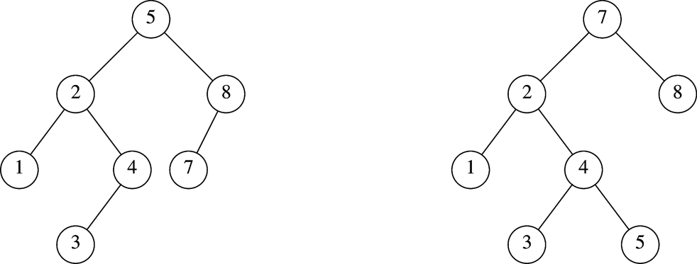
Which is an AVL Tree?
1
2
-1
1
1
0
0
1
0
0
0
0
0
0

Slide 8
AVL Tree Insert and Remove
Do binary search tree insert and remove
The balance condition can be violated sometimes
Do something to fix it : rotations
After rotations, the balance of the whole tree is maintained

Slide 9
Balance Condition Violation
If condition violated after a node insertion
Which nodes do we need to rotate?
Only nodes on path from insertion point to root may have their balance altered
Rebalance the tree through rotation at the deepest node with balance violated
The entire tree will be rebalanced
Violation cases at node k (deepest node)
An insertion into left subtree of left child of k
An insertion into right subtree of left child of k
An insertion into left subtree of right child of k
An insertion into right subtree of right child of k
Cases 1 and 4 equivalent
Single rotation to rebalance
Cases 2 and 3 equivalent
Double rotation to rebalance

Slide 10
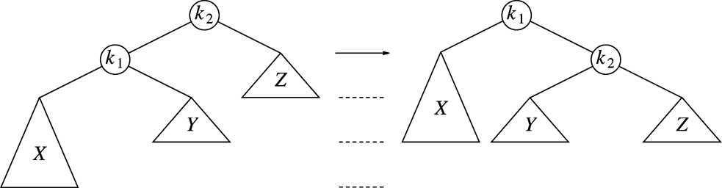
Single Right Rotation
Single rotation: The basic operation we’ll use to rebalance
Move child of unbalanced node into parent position
Parent becomes the “other” child (always okay in a BST!)
Other subtrees move in only way BST allows (we’ll see in generalized example)
Replace node k₂ by node k₁
Set node k₂ to be right child of node k₁
Set subtree Y to be left child of node k₂
Case 4 is similar
10
Notes:
10

Slide 11
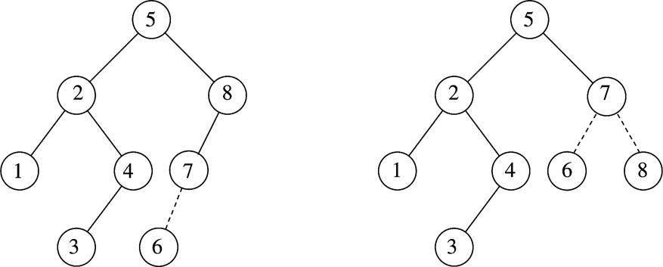
Example
After inserting 6
Balance condition at node 8 is violated
Perform Right Rotation on 8

Slide 12
Generalizing…
12
5
23
2
9
18
30
1
4
7
10

Slide 13
Generalizing our examples…
12
5
23
2
9
18
30
1
4
7
10

Slide 14
Generalizing our examples…
12
5
E
A
C

Slide 15
Generalizing our examples…
d
12
b
E
A
C

Slide 16
Generalized Single Rotation
d
b
E
A
C

Slide 17
Generalized Single Rotation
b
A
d
C
E

Slide 18
Single Rotations

Slide 19
Insertion Case #1 Left Left
Z
y
Y
T4
x
z
X
T3
T1
T2
T3
T4
T1
T2
Right Rotate on z

Slide 20
Insert Case # 1 Example
15
15
8
22
8
19
4
10
19
24
4
10
17
22
3
6
17
20
16
3
6
20
24
16

Slide 21
Insert Case #2 Right Right
Z
y
Left Rotate on z
T1
y
z
x
T2
x
T1
T2
T3
T4
T3
T4

Slide 22
Insert Case # 2 Example
15
15
8
22
8
24
4
10
19
24
4
10
22
25
3
6
3
6
19
23
23
25
26
26

Slide 23
Example
Inserting 3, 2, 1, and then 4 to 7 sequentially into empty AVL tree
3
2
2
1
3
1

Slide 24
Example
2
Inserting 4
Inserting 5
1
3
4
2
2
1
3
4
1
4
5
3
5

Slide 25
Example
4
2
2
5
Inserting 6
Inserting 7
1
4
1
3
6
3
5
6
4
4
2
6
2
5
1
3
5
7
1
3
6
7

Slide 26
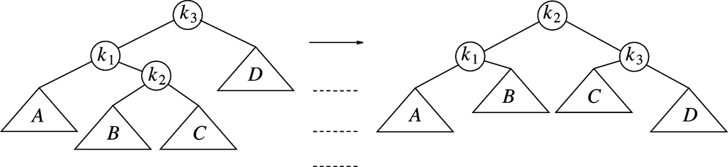
Double Rotation
Left-right double rotation to fix
First rotate between k₁ and k₂
Then rotate between k₂ and k₃

Slide 27
Insert Case # 3 Right Left
Right Rotate on y
Left Rotate on z
x
Z
Z
z
y
T1
y
T1
x
T1
T2
T3
T4
X
T4
T2
y
T2
T3
T3
T4

Slide 28
Insert Case #4 Left Right
Left Rotate on y
Right Rotate on z
x
Z
Z
y
z
y
T4
T4
x
T1
T2
T3
T4
T1
x
y
T3
T2
T3
T1
T2

Slide 29
Example
Continuing the previous example by inserting
16 down to 10, and then 8 and 9
Inserting 16 and 15
4
4
4
2
6
2
6
2
6
1
3
5
7
15
1
3
5
7
1
3
5
15
16
7
16
15
16
29
Notes:
29

Slide 30
Inserting 14
4
4
Left Rotate on 6
4
Right Rotate on 15
2
6
2
6
2
7
1
3
5
7
1
3
5
15
15
1
3
6
15
7
16
16
5
14
14
16
14
30
Notes:
30

Slide 31
AVL Deletion Algorithm
Recursive
Search downward for node
Delete node
Unwind, correcting heights as we go
a. If imbalance is left-left or right-right,
single rotate
b. If imbalance right-left or left-right,
double rotate

Slide 32
Deletion Case #1
Delete(12)
0
10
1
-1
5
17
-1
0
0
-1
2
9
12
20
0
0
3
30

Slide 33
Single Rotation on Deletion
0
1
10
10
1
-2
1
0
5
17
5
20
-1
0
-1
-1
0
0
0
2
9
20
2
9
17
30
0
0
0
3
30
3
Deletion can differ from insertion – How?
Deletion can propogate

Slide 34
Deletion Case #2 - Propogation
Delete(9)
-1
10
1
0
5
17
-1
0
-1
-1
12
2
9
12
20
20
0
0
1
0
-1
3
30
11
15
30
15
18
0
0
0
0
0
33
13
33
13

Slide 35
Double Rotation on Deletion
Not finished!
-1
-2
10
10
2
0
0
0
5
17
3
17
-1
-1
-1
0
0
-1
-1
2
12
12
2
20
2
5
20
0
0
1
0
-1
0
1
0
-1
3
11
15
18
30
11
15
18
30
0
0
0
0
0
13
33
13
33

Slide 36
Deletion with Propagation
-2
10
0
0
3
17
0
0
-1
-1
2
5
12
20
0
1
0
-1
11
15
18
30
0
0
13
33

Slide 37
Propagated Single Rotation
-2
1
10
17
0
0
-1
-1
3
17
10
20
0
0
-1
-1
0
-1
0
-1
2
5
12
20
3
12
18
30
0
1
0
-1
0
0
0
1
0
11
15
18
30
2
5
11
15
33
0
0
0
13
33
13

Slide 38
Pros & Cons
Arguments for AVL trees:
All operations logarithmic worst-case because trees are always balanced
Height balancing adds no more than a constant factor to the speed of insert and delete
Arguments against AVL trees:
Difficult to program & debug
More space for height field
Asymptotically faster but rebalancing takes time

Slide 39
AVL Tree Example:
Insert 14, 17, 11, 7, 53, 4, 13 into an empty AVL tree
14
11
17
7
53
4

Slide 40
AVL Tree Example:
Insert 14, 17, 11, 7, 53, 4, 13 into an empty AVL tree
14
7
17
4
11
53
13

Slide 41
AVL Tree Example:
Now insert 12
14
7
17
4
11
53
13
12

Slide 42
AVL Tree Example:
Now insert 12
14
7
17
4
11
53
12
13

Slide 43
AVL Tree Example:
Now the AVL tree is balanced.
14
7
17
4
12
53
11
13

Slide 44
AVL Tree Example:
Now insert 8
14
7
17
4
12
53
11
13
8

Slide 45
AVL Tree Example:
Now insert 8
14
7
17
4
11
53
8
12
13

Slide 46
AVL Tree Example:
Now the AVL tree is balanced.
14
11
17
7
12
53
4
8
13

Slide 47
AVL Tree Example:
Now remove 53
14
11
17
7
12
53
4
8
13

Slide 48
AVL Tree Example:
Now remove 53, unbalanced
14
11
17
7
12
4
8
13

Slide 49
AVL Tree Example:
Balanced! Remove 11
11
7
14
4
8
12
17
13

Slide 50
AVL Tree Example:
Remove 11, replace it with the largest in its left branch
8
7
14
4
12
17
13

Slide 51
AVL Tree Example:
Remove 8, unbalanced
7
4
14
12
17
13

Slide 52
AVL Tree Example:
Remove 8, unbalanced
7
4
12
14
13
17

Slide 53
AVL Tree Example:
Balanced!!
12
7
14
4
13
17

